Slide 1
Node.js OS Module
The OS module provides information about the computer's operating system.
The syntax for including the OS module in your application:
var os = require(‘os');

Slide 2
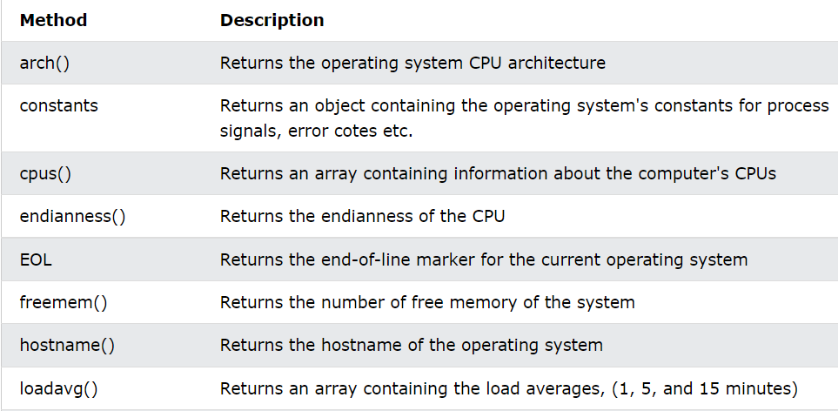
OS Properties and Methods

Slide 3
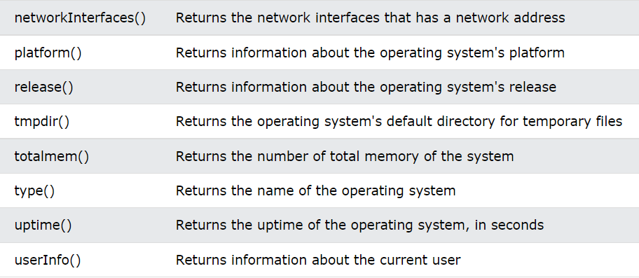
OS Properties and Methods

Slide 4
Node.js Path Module
Get information about the computer's operating system:
var os = require('os'); console.log("Platform: " + os.platform()); console.log("Architecture: " + os.arch());

